Slide 1
Computer Vision SOTa model
cnn architectures and more

Slide 2
Table of contents
ImageNet dataset
ImageNet Challenge
Vanilla CNN – the first CNN based winner
Inception Net
Residual Net
Inception - Residual Net
DenseNet
MobileNet
EfficientNet

Slide 3
Imagenet
An image database organized according to the WordNet hierarchy (only the nouns)
Over 14 milion images organized into 21,841 subcategories
On average, there are over 500 images per subcategory
As many as 1,034,908 images have been annotated with bounding boxes
1000 subcategories with SIFT features covering about 1.2 million images
The images vary in dimensions and resolution. Many applications resize / crop all of the images to 256x256 pixels.

Slide 4
Imagenet Challenge
*Image from Standford University
ImageNet Large Scale Visual Regconition Challenge (ILSVRC) evaluates algorithms for object detection and image classification at large scale on ImageNet dataset
First competition in 2010, last one in 2017
Lead to the explosion of CNN architectures in Computer Vision tasks
The most powerfull models (from ResNet in 2015) has exceed Human level in this competition’s problem (Image Classification, Object dectection, Object recognition)

Slide 5
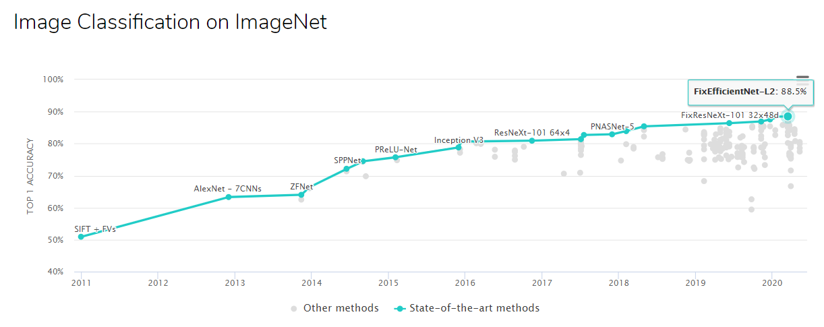
Imagenet Challenge
ImageNet Challenge winer through year
https://paperswithcode.com/sota/image-classification-on-imagenet

Slide 6
Metrics
For classification task
Accuracy
Top-1 accuracy: Predicted label should match ground truth label
Top-5 accuracy: Ground truth label match one of 5 highest-score predicted label
Error rate
The percentage of wrong prediction

Slide 7
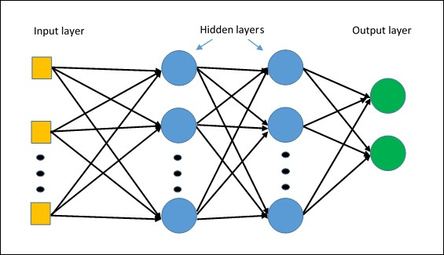
Vanilla architecture
“Vanilla” neural networks: an extension of linear regression with activation function, backpropagation gradient calculation and gradient based optimization algorithm

Slide 8


Vanilla architecture
Fully Connected Neural Network (FC)
* Image taken from CS231n – Standford University

Slide 9

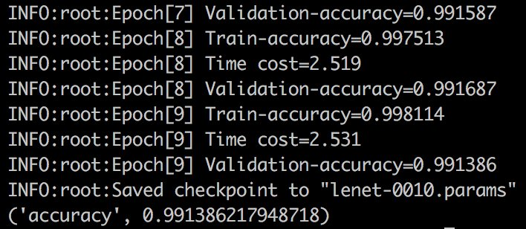
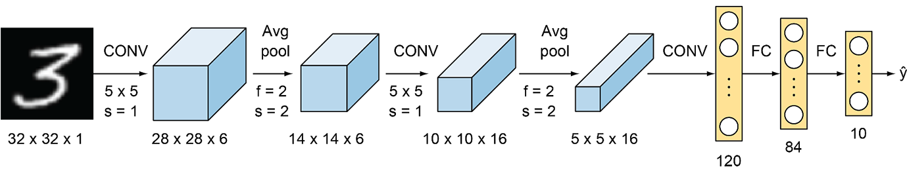
Vanilla CNN
LeNet-5 (1998)
First Convolutional Neural Network
5 layers: 2 CONVs with 5x5 filter + 3 FCs
Average pooling
Total 61,706 params (tiny with today’s standards)
Training #LeNet on #MNIST with a #P3 instance AWS – Julien Simon
Yannn LeCun
Full LeNet (1998) architecture by Yann LeCun on MNIST dataset
https://livebook.manning.com/book/grokking-deep-learning-for-computer-vision/chapter-5/v-3/19

Slide 10
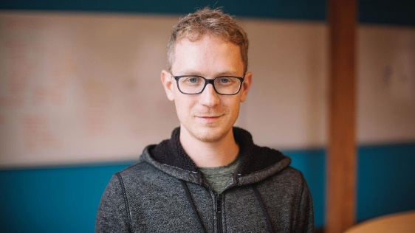
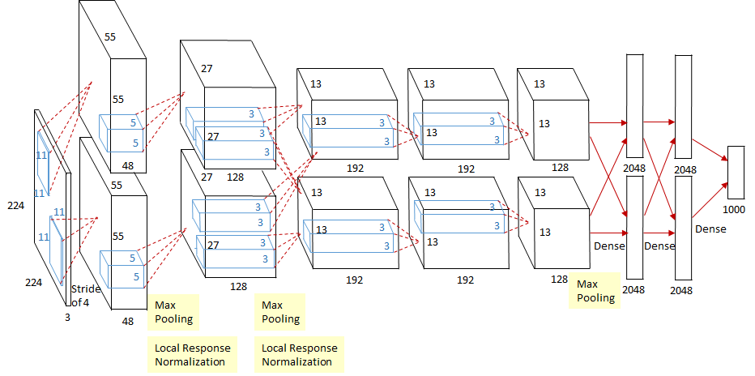
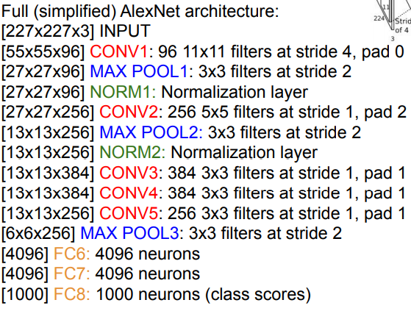
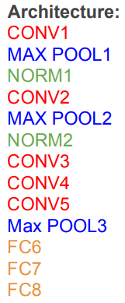
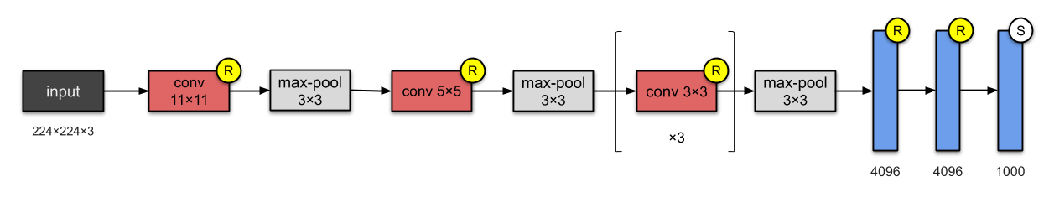
Alexnet (2012)
8 layers — 5 convolutional and 3 fully-connected
First CNN based winner of ILSVRC
Alex Krizhevsky

Slide 11
Alexnet (2012)
Novel features of AlexNet and Details training configuration
First use of ReLU activation function
Local Response Normalisation layer (nowadays, Batch Norm instead)
Overlapping Pooling
Heavy Data Augmentation
Dropout 0.5
Batch size: 128
SGD Momentum 0.9
Learning rate 1e-2, reduced by 10 manually when val-accuracy plateaus
L2 weight decay 5e-4
Initialize weights in each layer from a N(0, 0.01^2) distribution and bias of constant 1 (except layer 1, 3 constant 0) to provide ReLUs with positive input
Trained on GTX 580 GPU with only 3GB of memory. Network spread across 2 GPUs, half the neurons (feature maps) on each GPU. Took 5-6 days to train.
CS231n – Standford University
Alex et al - ImageNet Classification with Deep Convolutional Neural Networks, 2012

Slide 12
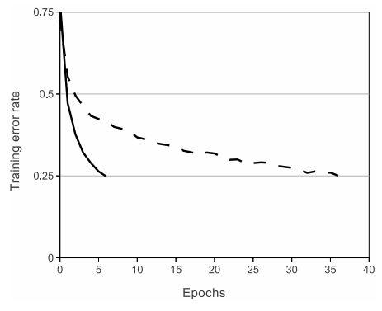
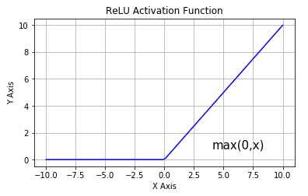
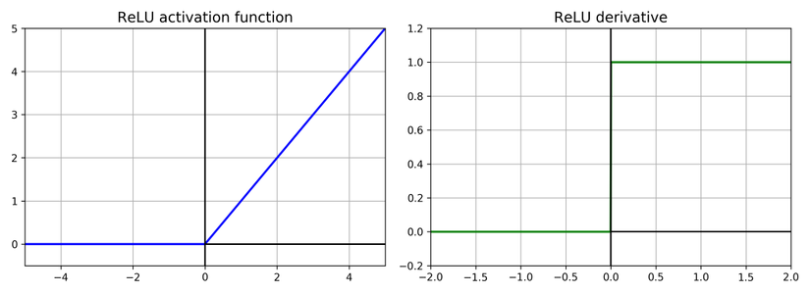
Alexnet (2012)
ReLU (Rectified Linear Unit) Non-linearity
Faster training with gradient based optimizer
Faster feed-forward prediction
Reduce vanishing gradient
A four-layer convolutional neural network with ReLUs (solid line) reaches a 25% training error rate on CIFAR-10 six times faster than an equivalent network with tanh neurons (dashed line).
What is the gradient of ReLU on x?
1 for x>0 and 0 for x<0
Alex et al - ImageNet Classification with Deep Convolutional Neural Networks, 2012

Slide 13
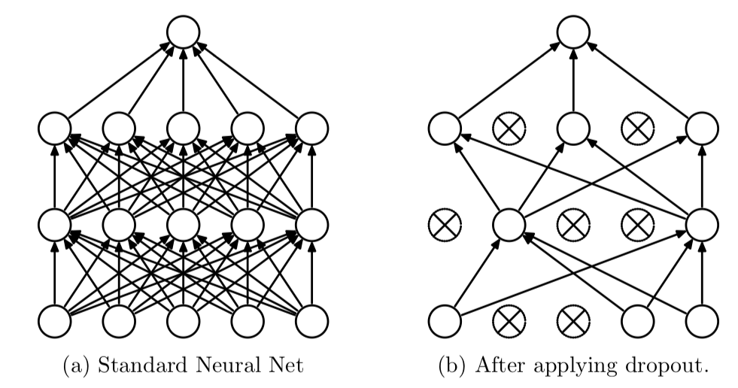
Alexnet (2012)
Dropout regularization technique
In each forward pass of training time, randomly set some neurons to zero
Probability of dropping is a hyperparameter; 0.5 is common
Use all neurons in test time but multiply their output by dropping probability
Roughly double the number of iterations require to converge
Dropout like training a large ensemble of models that share params
Each binary mask (1-0 mask for a layer) is one model
An FC layer with 4096 units has 2^4096 ~ 10^1233 possible masks! Only ~ 10^82 atoms in the universe...
Alex et al - ImageNet Classification with Deep Convolutional Neural Networks, 2012
CS231n Stanford University

Slide 14
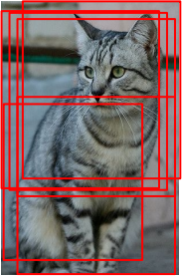
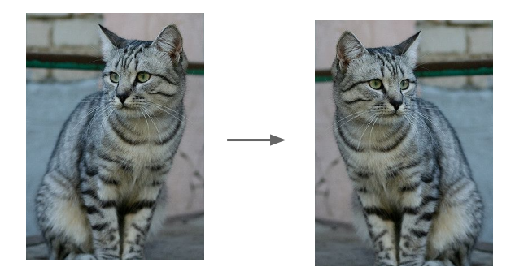
Alexnet (2012)
Data Augmentation
Image translations: extract tin random 224x224 patches from the 256x256 images and training on these extracted patches. This increases the size of the training set by a factor of 2048, though the resulting training examples are highly interdependent.
Image reflections: horizontally flip the extracted of previous step.
This is the reason why the network input are 224x224x3 dims
Extract 224x224 patches
Horizontally flips

Slide 15
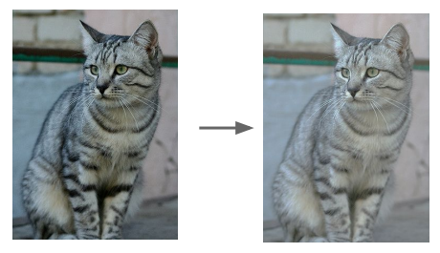
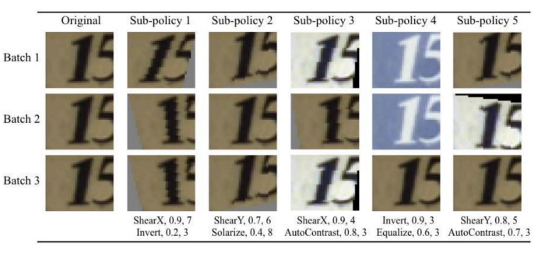
Alexnet (2012)
Data Augmentation
Color offset: randomly offset RGB channels
Take away: to do Data augmentation, we can random mix/combine:
Translation
Rotation
Stretching
Shearing
Lens distortions …
Randomize contrast and brightness
This scheme reduces the top-1 error rate by over 1%.
Automatic Data Augmentation

Slide 16
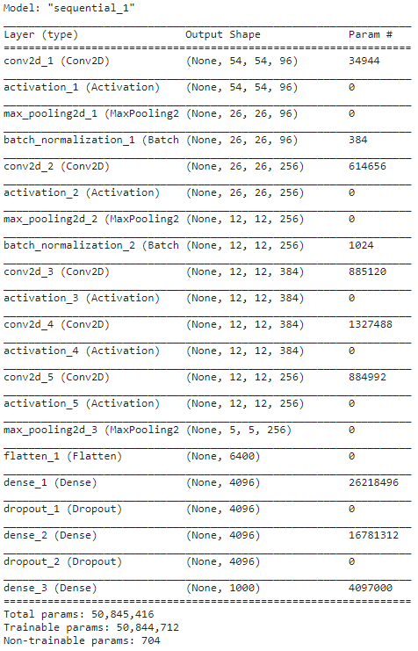
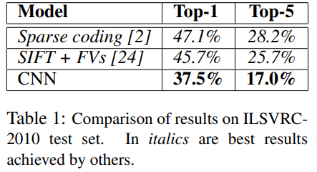
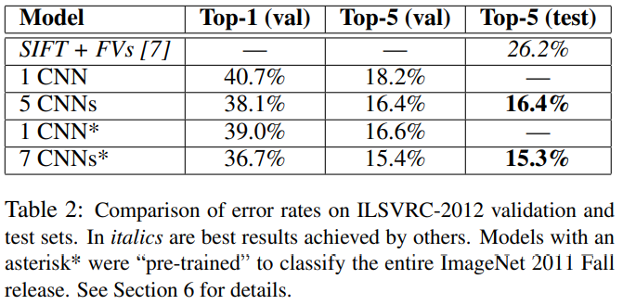
Alexnet (2012)
Implementation and results

Slide 17
Alexnet (2012)
Discussion
First CNN model winner, outperformed all the prior competitors.
Break the “mindset” that “hand worked” feature extractor e.g HOG, SHIFT, SURF better than automatically learning CNN filter. Efficient ReLU activation function
Perform sota overfitting reduce methods in a single model:
Data Augmentation method can reduce overfitting, allow using more complicated model
Efficient Dropout regularization layer
Show that large, deep convolutional neural network is capable of achieving record-breaking results on a highly challenging dataset using purely supervised learning
Blow up the application of Deep Learning and CNN architectures in Computer Vision tasks

Slide 18
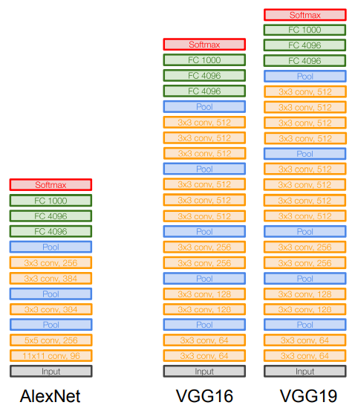
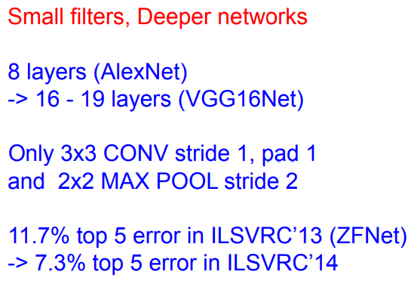
VGG Net (2014)
Simonyan and Zisserman, 2014
The expansion of AlexNet

Slide 19
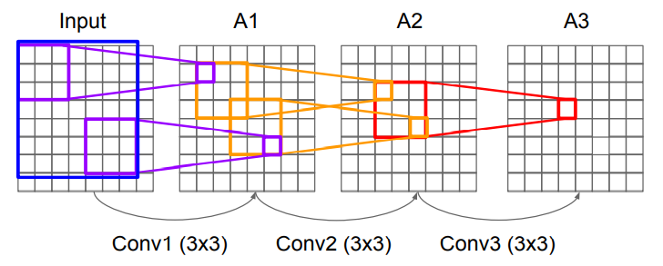
VGG Net (2014)
Why use smaller filter?
Stack of three 3x3 conv (stride 1) layers has same effective receptive field as one 7x7 conv layer
But deeper -> more non-linearities; And fewer params 3x(3x3xC) < 7x7xC

Slide 20
VGG Net (2014)
Details Configuration and novel features
Conv block with smaller filter (3x3) produce more non-linearities, extract features better and less params (than Alex net Conv layer)
Deeper network: 16-19 layers with 5 Conv block consist of 13 conv layers (AlexNet have 8 layers with 3 Conv block)
ReLU activation function from AlexNet
No Local Response Normalisation (LRN)
One of the biggest (number of params) network
19 layers version produce slightly better results
Similar training procedure as Alex in 2012
Shaping a common architecture: deeper network with multi Conv block - [Conv+ ~ Max Pooling]+
Consolidate the theory of deeper network can perform better results on the same dataset

Slide 21
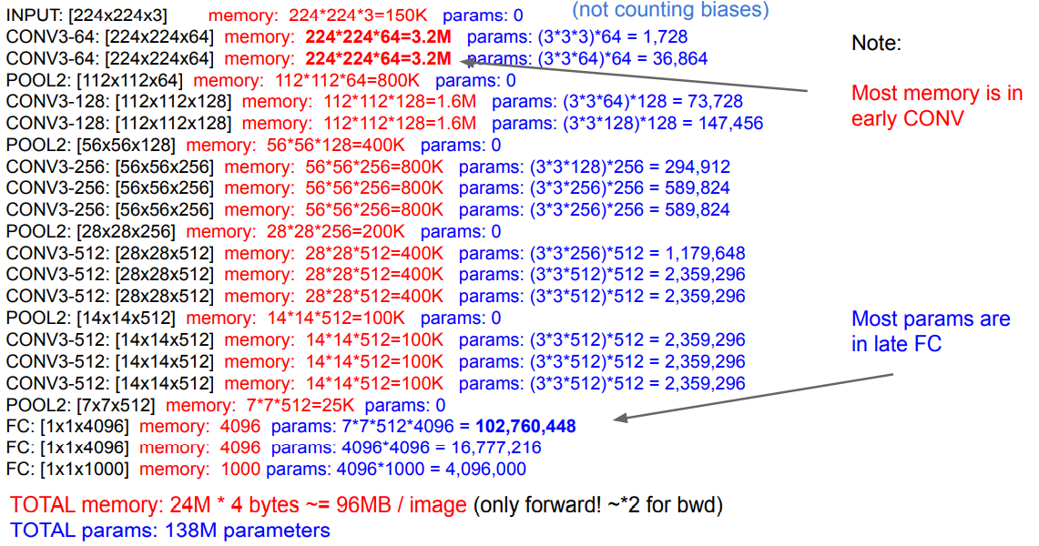
VGG Net (2014)
Slides taken from CS231n – Stanford University
Where is the heavy part?

Slide 22
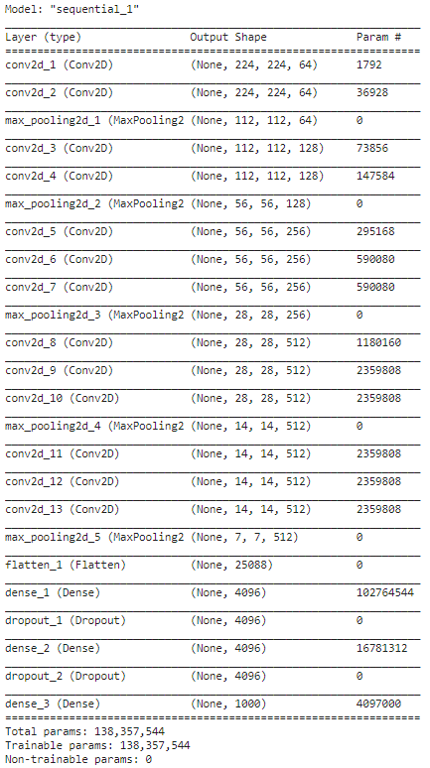
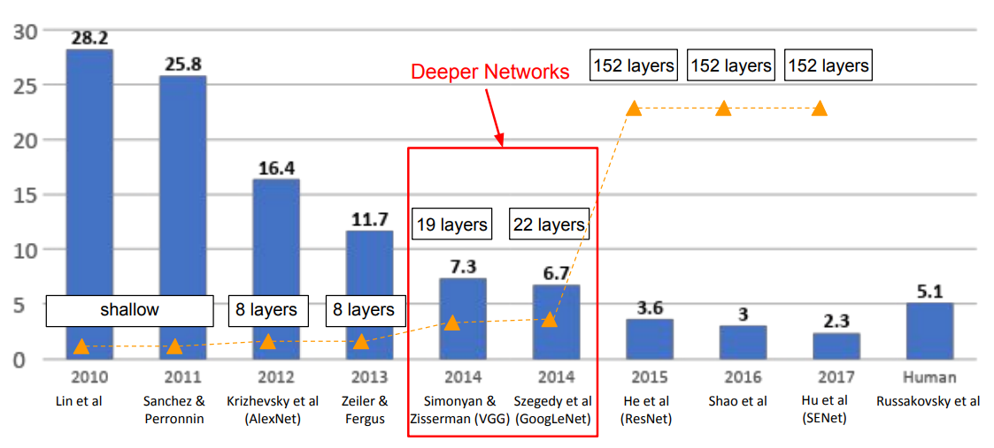
VGG Net (2014)
Implementation and results
ILSVRC’2014 2nd in classification, 1st in localization
VGG-16 achieved the top-5 error rate of 8.1% on ImageNet compared to 16.4% achieved by AlexNet. Even better accuracy with the VGG-19 where it was able to achieve a top-5 error rate of ~ 7.3%

Slide 23

Vanilla cnn architecture
Conclusion
Deep Vanilla CNN can perform better results than traditional features extracting e.g SIFT, SURF, HOG…
Deeper network tend to perform better results
Use continuous Conv block with smaller filter instead of single layer with large filter not only give better performance but also higher results (because of more non-linearities)
ReLU activation instead of Sigmoid, Tanh for faster training and prediction
Dropout regularization and Data Augmentation can reduce overfitting, give us the ability to build larger network
Ensemble technique produce more general network and better results
But, the number of params still increasing?
The final FC layer seems extreme heavy, dramatically increase network’s params, put model to the risk of overfitting

Slide 24
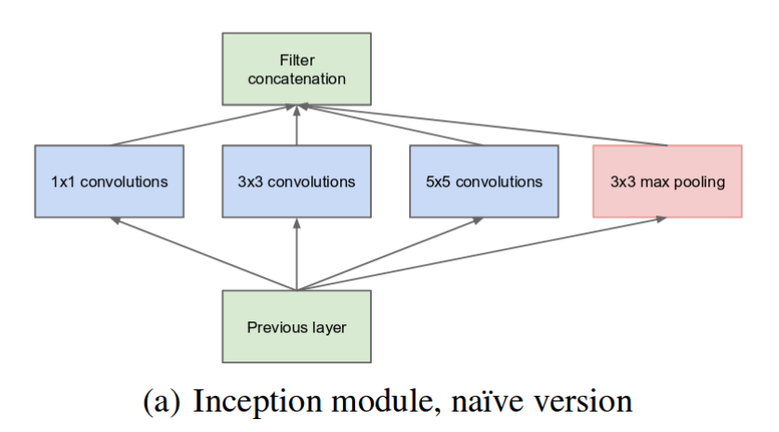
Inception NET
Which kernel size should be use for each Conv layer?
Inception module with parallel kernel
Multiple kernel: 1x1, 3x3, 5x5
Max pooling
Output: Depth wise concatenation of these
Szegedy et al – Going deeper with convolutions, 2014

Slide 25
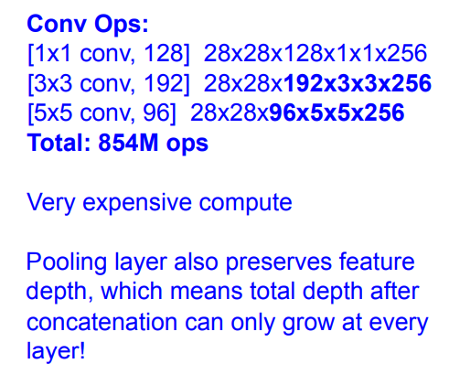
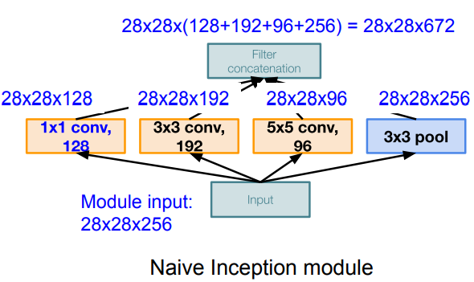
Inception NET
What is problem with this architecture?
Pooling layer also preserves feature depth, which means total depth after concatenation can only grow at every layer!

Slide 26
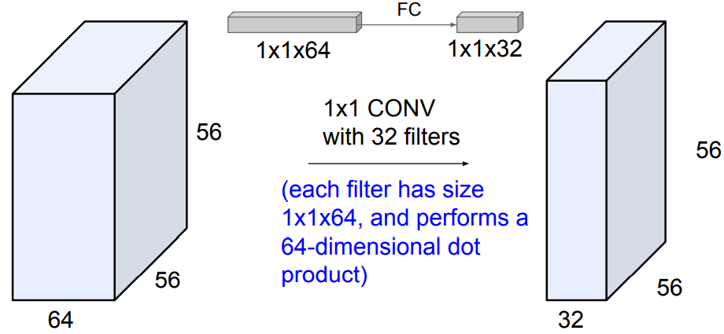
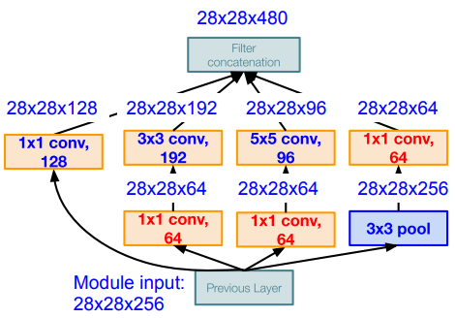
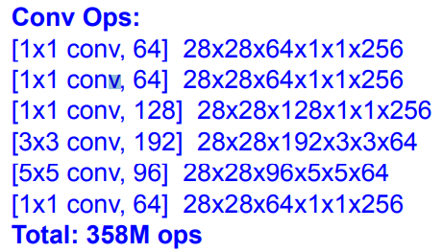
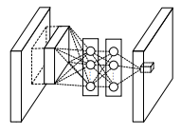
Inception NET
Solution: Use bottleneck (1x1) convolutions layer to reduce feature channel size
Alternatively, interpret it as applying the same FC layer on each input pixel -> same as Network In Network, Min Lin et al
MLPConv Layer - Lin et al, 2014
CS231n – Stanford University, 2020

Slide 27
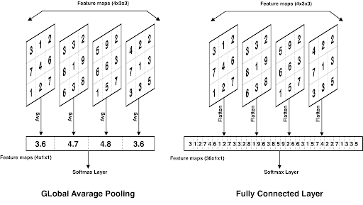
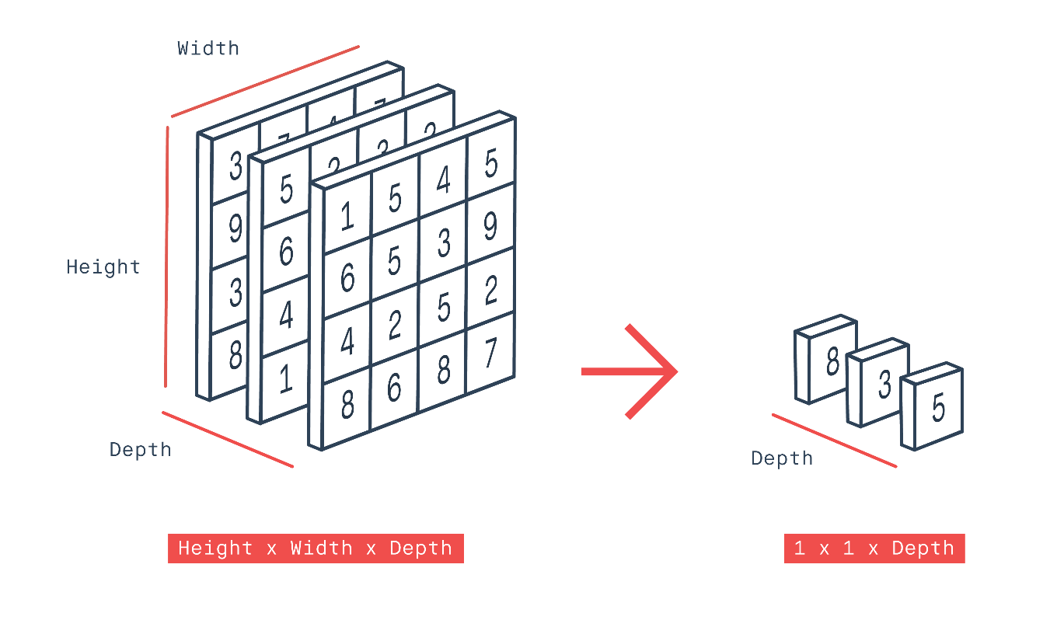
GoogleNet
Global Average Pooling (GAP) layer
Adding an 7x7 average pooling improved the top-1 accuracy by about 0.6%
- GAP layers reduce each h×w feature map to a single number by simply taking the average of all values in each slice
- The GAP layer then followed by one densely connected layer with a softmax activation function that yields the predicted object classes.

Slide 28
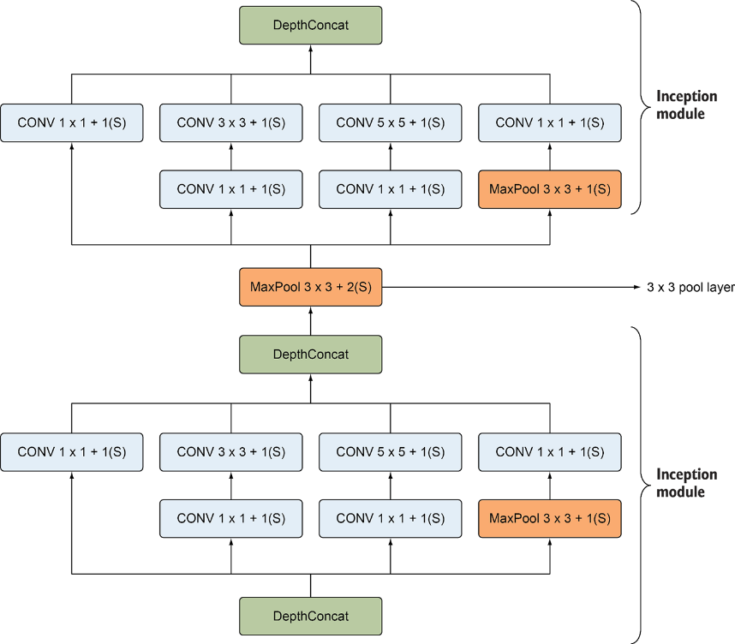
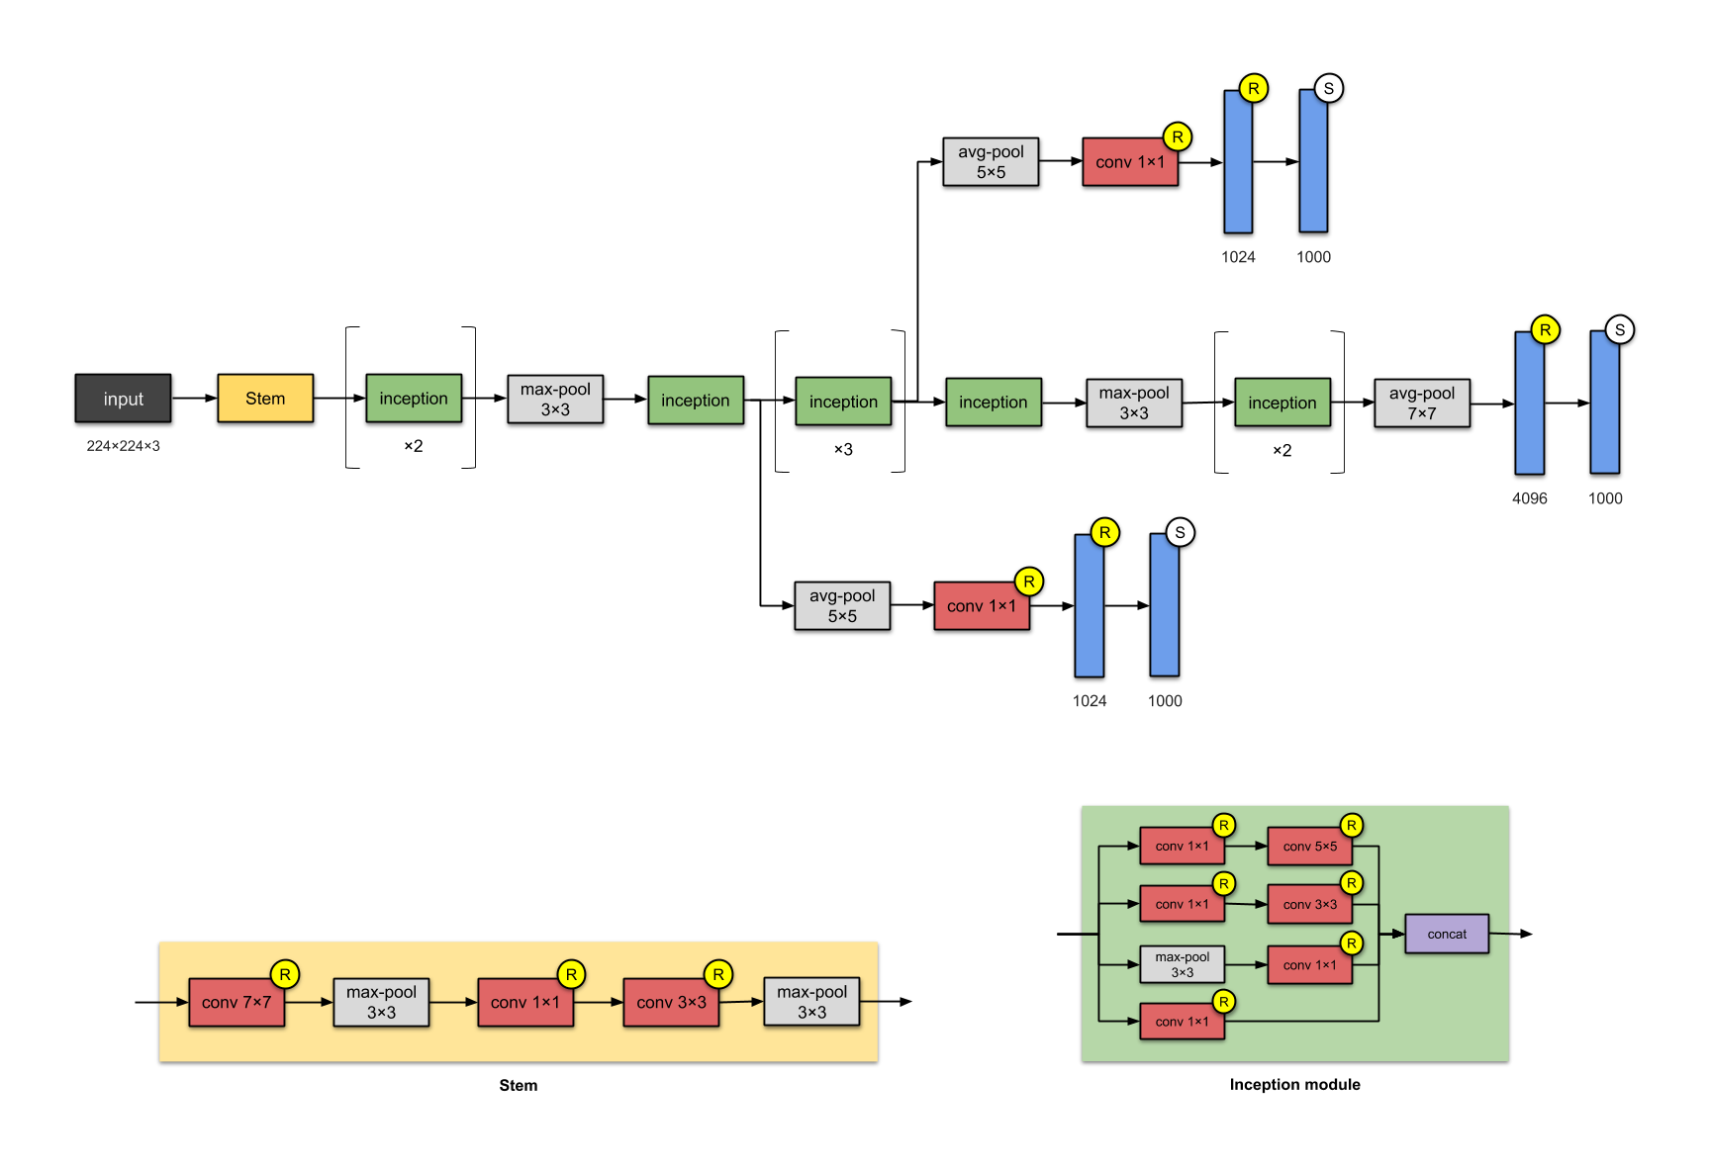
GoogleNet
Inception-v1: 9 Inception modules with 22 layers
Stacked Inception module with Max Pooling layer between
Only 5 millions params, 27x less than VGG-16
Only FC-1000 to output classes
Part B: Staked Inception Module
Part A: Vanilla Input
Part C: The classifier

Slide 29
GoogleNet (inception-v1)
Strong performance of relatively shallower networks on this task suggests that the features produced by the layers in the middle of the network should be very discriminative.
Adding auxiliary classifiers connected to these intermediate layers, encourage discrimination in the lower stages in the classifier, increase the gradient signal that gets propagated back, and provide additional regularization.
During training, their loss gets added to the total loss of the network with a discount weight (the losses of the auxiliary classifiers were weighted by 0.3). At inference time, these auxiliary networks are discarded.
Auxiliary classifiers at lower layers

Slide 30
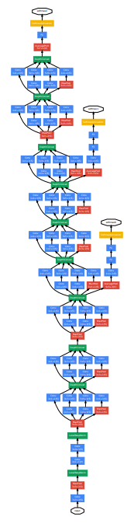
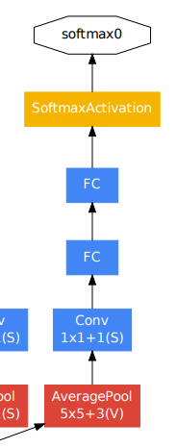
GoogleNet (inception-v1)
The auxiliary classifier structure as follows:
An average pooling layer with 5×5 filter size and stride 3, resulting in an 4×4×512 output for the (4a), and 4×4×528 for the (4d) stage
A 1×1 convolution with 128 filters for dimension reduction and rectified linear activation.
A fully connected layer with 1024 units and rectified linear activation.
A dropout layer with 70% ratio of dropped outputs.
A linear layer with softmax loss as the classifier (predicting the same 1000 classes as the main classifier, but removed at inference time)
Szegedy et al – Going deeper with convolutions, 2014

Slide 31
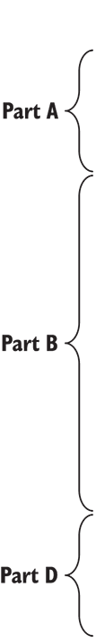
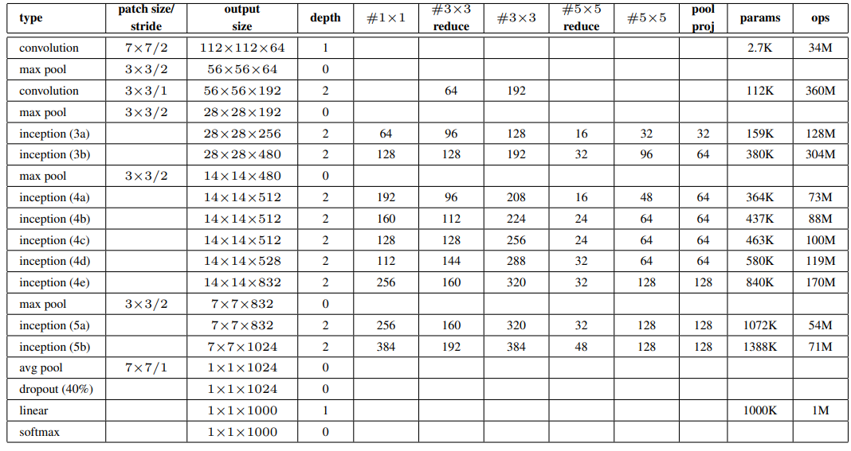
GoogleNet (inception-v1)
Details Configuration (Main classifier)

Slide 32
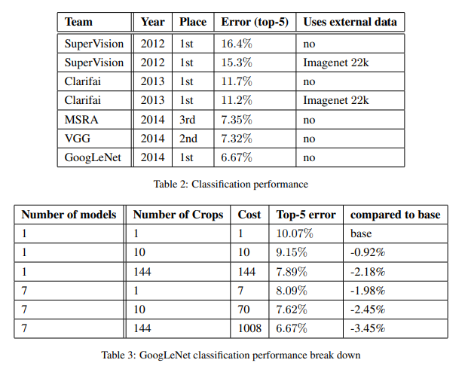
GoogleNet (inception-v1)
Implementation and results
Training 7 version of the same GoogleNet model (only differ in sampling methodologies and the random order in which they see input images)
Perform ensenble predict with these 7 versions for best results of 6.67% top-5 error
Szegedy et al – Going deeper with convolutions, 2014

Slide 33
Inception net
Conclusion
Deeper model perform better results
Network In Network structure with Inception module use multi-size parallel conv layer to extract more type of features from input image
Use ‘bottle neck’ 1x1 conv layer for dimension reduction, control the ouput size of each module
Use Global Average Pooling instead of FC to reduce the number of params, avoid overfitting and ofcourse, reduce network size for faster training, predicting, easier deployment
Auxiliary classifier extract earlier layers in which the gradient carry more information, reduce the affect of ‘vanishing gradient’ problem in deep networks
Szegedy et al – Going deeper with convolutions, 2014
https://stats.stackexchange.com/questions/274286/google-inception-modelwhy-there-is-multiple-softmax
Notes:
Given the relatively large depth of the network, the ability to propagate gradients back through all the layers in an effective manner was a concern. It’s the fact that not only the features of the final layers that carry all the discriminatory information

Slide 34
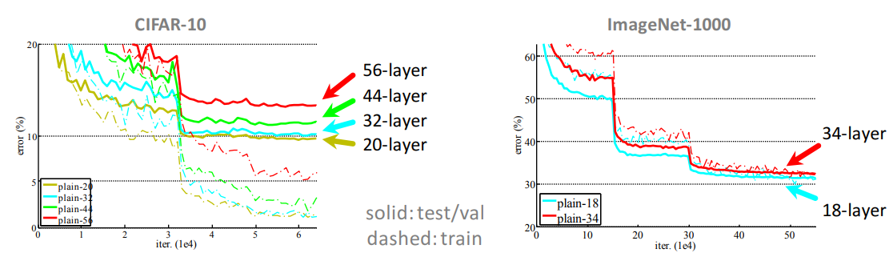
Residual net
Is learning better networks as simple as stacking more layers?
“Overly deep” plain nets have higher training error but it’s not caused by overfitting!
Hypothesis: the problem is an optimization problem, deeper models are harder to optimize!
He et al – Deep Residual Learning for Image Recognition. 2015

Slide 35
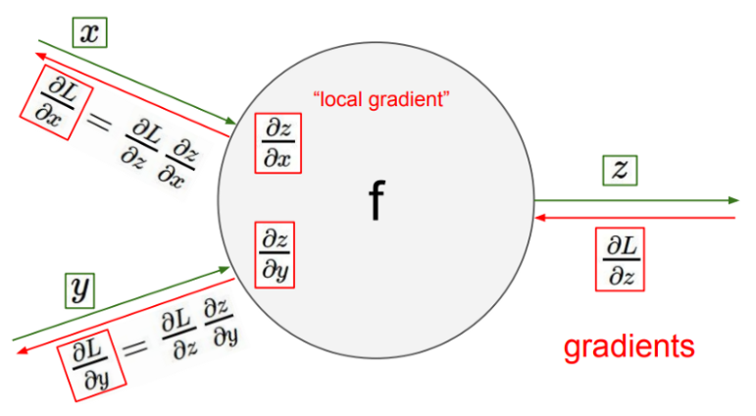
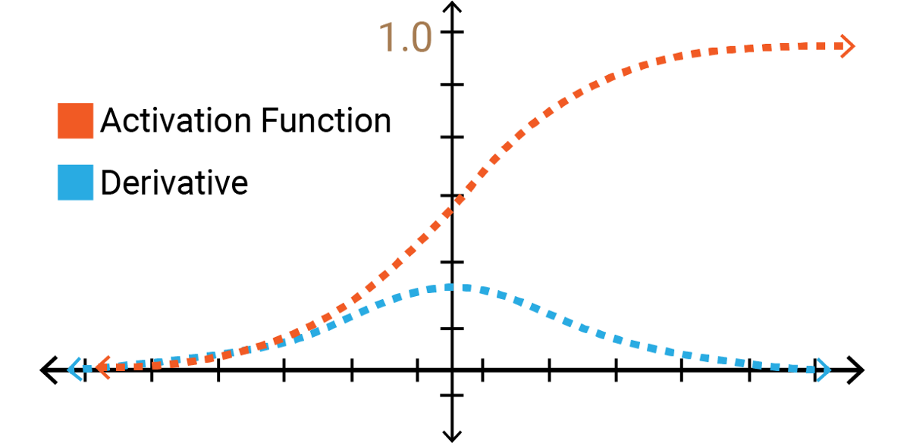
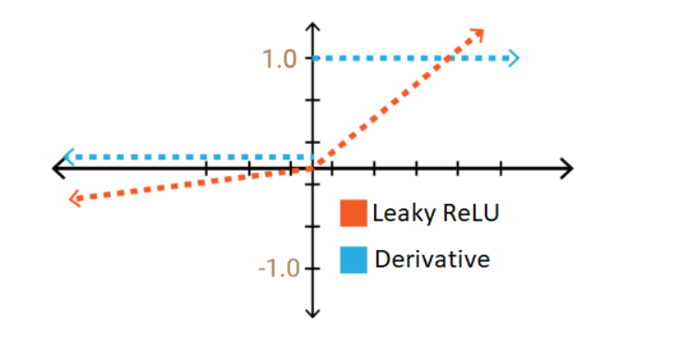
Residual net
Vanishing Gradient
Found in training NN with gradient based methods
Consequence of backopropagation learning algorithm with chain rule
Really hard to tune params of the earlier layers
https://towardsdatascience.com/the-problem-of-vanishing-gradients-68cea05e2625

Slide 36
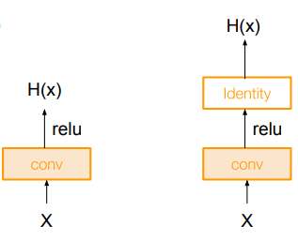
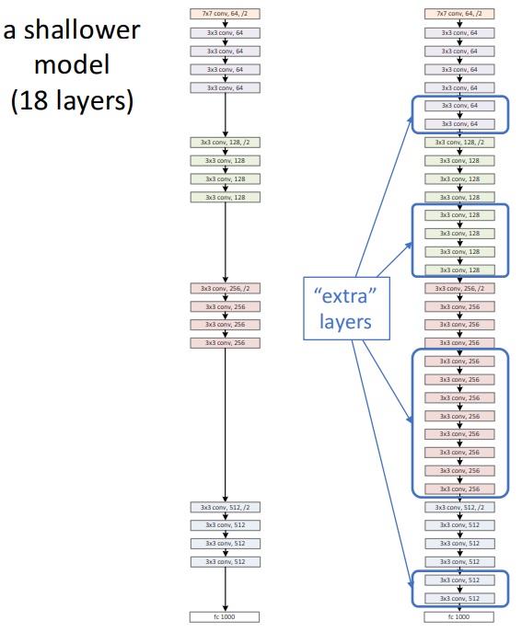
Residual net
a deeper counterpart (34 layers)
Richer solution space
A deeper model should not have higher training error
A solution by construction:
original layers: copied from a learned shallower model
extra layers: set as identity
at least the same training error
Optimization difficulties: solvers cannot find the solution when going deeper…
He et al – Deep Residual Learning for Image Recognition. 2015

Slide 37
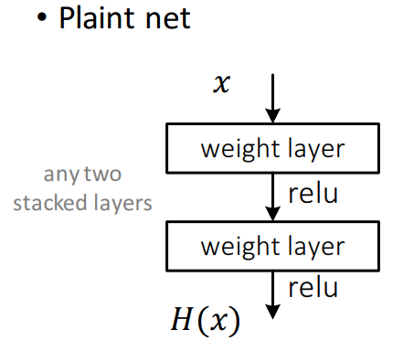
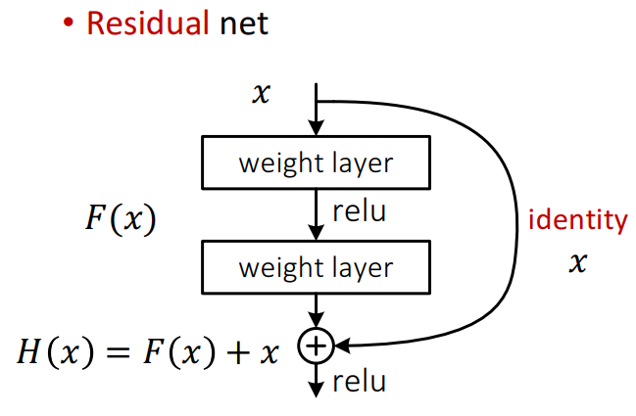
Residual net
H(x) is any desired mapping
hope the 2 weight layers fit H(x)
Hope the 2 weight layers fit F(x)
Let H(x) = F(x) + x
H(x) is any desired mapping
hope the 2 weight layers fit H(x)
He et al – Deep Residual Learning for Image Recognition. 2015

Slide 38

Residual Net
GAP layer after last Conv layer (like GoogleNet)
Stack residual blocks
Every residual block has two 3x3 conv layers
Periodically, double # of filters and downsample spatially using stride 2 (/2 in each dimension)
Additional conv layer at the beginning (stem)
No FC layers at the end (only FC 1000 to output classes)
Total depths of 18, 34, 50, 101, or 152 layers for ImageNet
CS231n – Stanford University

Slide 39

Residual Net
Use ‘bottle neck’ layer for dimensions reduction (GoogleNet 2014)

Slide 40

ResNet (2015)
ResNet-50 architecture:
Stack residual blocks
Every residual block has two 3x3 conv layers
Additional conv layer at the beginning (stem, 7x7)
No FC layers at the end (only FC 1000 to output classes)
Batch normalization at each conv layer
152 layers, 26 million params in total
The shortcut path with conv 1x1 in Conv block to ensure dimension matching

Slide 41

ResNet (2015)
Implementation
Batch Normalization after every CONV layer
Xavier initialization from He et al.
Learning rate: 0.1, divided by 10 when validation error plateaus
SGD + Momentum (0.9)
Mini-batch size 256
Weight decay of 1e-5
No dropout used
He et al – Deep Residual Learning for Image Recognition. 2015

Slide 42

ResNet (2015)
Results
He et al – Deep Residual Learning for Image Recognition. 2015
Notes:
Results on CIFAR-10 compare to plain nets

Slide 43

ResNet (2015)
Results
Notes:
Results on ImageNet compare to plain nets

Slide 44



ResNet (2015)
Results
An ensemble of 6 models with different depths

Slide 45
ResNet (2015)
Conclusion
Use skip connection to create “identity function” which ensures the layer performs at least as good as the plain layer;
Inheritate “bottle neck” conv 1x1 layer from GoogleNet for dimension reduction and faster training, control the output channels (perform addition)
Use Conv block when we want to change (reduce) output dims from input (parallel structure similar to GoogleNet)
GAP layer instead of expensive FCs layer at output classifier
Does not need Auxiliary classifier cause of easier gradient flow through out the network
Now deeper network now perform better as expected!

Slide 46


Slide 47


DenseNet
Standard Conectivity
ResNet Conectivity: Identity mappings promote gradient propagation
Huang et al – Densely Connected Convolutional Networks, 2017

Slide 48
DenseNet
Context
“Vanshing gradient” is a significant problem when building and training a deep network
The recent network (ResNet, Highway Network) trying to address this problem by create short paths from early layers to later layers or stochastic depth ResNet by randomly dropping layers during the training to explicit preserve information flow (gradient)
Skip connection shows that many layer in network contribute very little and can in fact be randomly dropped during training
Inception net (GoogleNet) and variant of ResNets prove that simply increase the width of each layer can improve network’s performance provided the depth is sufficient

Slide 49



DenseNet
In ResNet, we construe a function into an identity and a non-linearity function
We have Taylor expansion at x=0
Realize that ResNet function look the same with Taylor expansion at f’(x) and g(x) = o(x)
We have known that the higher level of gradient for f(x) we can do, the more accurate of approximation we got
Same idea, Dense blocks where each layer is connected to every other layer in feedforward fashion

Slide 50


DenseNet
Dense Conectivity
Instead of wide or deep, DenseNets exploit the potential of the network through feature reuse
Concatenating feature-maps learned by different layers increases variation in the input of subsequent layers and improves efficiency
Concatenating features from different layers as Inception nets, skip connection like ResNet?
But more compact!
Each layer is receiving
a “collective knowledge” from all preceding layers.
Huang et al – Densely Connected Convolutional Networks, 2017
Notes:
Instead of drawing representational power from extremely deep or wide architectures, DenseNets exploit the potential of the network through feature reuse, yielding condensed models that are easy to train and highly parameterefficient.

Slide 51

DenseNet
Growth rate k is the additional number of channels for each layer (its own channels)
Huang et al – Densely Connected Convolutional Networks, 2017
Notes:
Instead of drawing representational power from extremely deep or wide architectures, DenseNets exploit the potential of the network through feature reuse, yielding condensed models that are easy to train and highly parameterefficient.

Slide 52


DenseNet
Composition Layers
For each composition layer, Pre-Activation (BN, ReLU then 3x3 Conv) are done with output feature maps of k channels, say for example, to transform x0, x1, x2, x3 to x4
This is the idea from Pre-Activation ResNet
Huang et al – Densely Connected Convolutional Networks, 2017
Notes:
Preactivation: add Activation to preceding layer before feed on subsequent layer

Slide 53

DenseNet
DenseNet-B with bottleneck layer
To reduce the model complexity and size, BN-ReLU-1×1 Conv is done before BN-ReLU-3×3 Conv.
Huang et al – Densely Connected Convolutional Networks, 2017
Notes:
Preactivation: add Activation to preceding layer before feed on subsequent layer

Slide 54

DenseNet
DenseNet-C
If a dense block contains m feature-maps, the transition layer generate $θ∗m$ output feature maps, where 0< $θ$≤1 is referred to as the compression factor.
When $θ =1$, the number of feature-maps across transition layers remains unchanged. DenseNet with $θ<1$ is referred as DenseNet-C, and $θ=0.5$ in the experiment.
When both the bottleneck and transition layers with $θ<1$ are used, the model is referred as DenseNet-BC.
Huang et al – Densely Connected Convolutional Networks, 2017
Notes:
Preactivation: add Activation to preceding layer before feed on subsequent layer

Slide 55

DenseNet
Dense network architecture
1×1 Conv followed by 2×2 average pooling are used as the transition layers between two contiguous dense blocks
Feature map sizes are the same within the dense block so that they can be concatenated together easily
Final, a global average pooling followed by a softmax classifier is attached
Huang et al – Densely Connected Convolutional Networks, 2017

Slide 56

DenseNet
Advantage 1: Strong gradient flow
Huang et al – Densely Connected Convolutional Networks, 2017
Notes:
Each layer has direct access to the gradients from the loss function and the original input signal, leading to an implicit deep supervision

Slide 57

DenseNet
Advantage 2: Parameter and computational efficiency
Huang et al – Densely Connected Convolutional Networks, 2017

Slide 58

DenseNet
Advantage 3: Maintains low complexity features
Huang et al – Densely Connected Convolutional Networks, 2017

Slide 59

DenseNet
Advantage 3: Maintains low complexity features
Huang et al – Densely Connected Convolutional Networks, 2017

Slide 60

DenseNet
DensNet detail architecture
Growth rate for all the networks is k = 32
Each “conv” layer shown in the table corresponds the sequence BN-ReLU-Conv.
Huang et al – Densely Connected Convolutional Networks, 2017

Slide 61
DenseNet
Implementation
Growth rate for all the networks is k = 32
Each “conv” layer shown in the table corresponds the sequence BN-ReLU-Conv.
Huang et al – Densely Connected Convolutional Networks, 2017

Slide 62

DenseNet
Results: On CIFAR-10
Huang et al – Densely Connected Convolutional Networks, 2017

Slide 63

DenseNet
Results: On CIFAR-100
Huang et al – Densely Connected Convolutional Networks, 2017

Slide 64

DenseNet
Deeper network but less params!
Results: On ImageNet
Huang et al – Densely Connected Convolutional Networks, 2017

Slide 65



DenseNet
Multi-Scale DenseNet
2.6x faster than ResNets and 1.3x faster than DenseNets at inference time
Huang et al – Multi-Scale DenseNet, 2017

Slide 66

Mobile-net
Depthwise Separable Conv is a depthwise convolution followed by a pointwise convolution
Depthwise convolution is the channel-wise spatial convolution.
Pointwise convolution actually is the 1×1 convolution to change the dimension.

Slide 67

Mobile-net

Slide 68



Mobile-net
If Standard Convolution vs Depthwise Separable Convolution for ImageNet dataset:
MobileNet only got 1% loss in accuracy, but the Mult-Adds and parameters are reduced tremendously.

Slide 69
Mobile-net
MobileNet-224 full architecture
Note that after each Conv layer is ReLU and BN

Slide 70
Mobile-net
Standard Convolution vs Depthwise Separable Convolution for ImageNet dataset:
MobileNet only got 1% loss in accuracy, but the Mult-Adds ops and parameters are reduced tremendously.

Slide 71


Mobile-net
When 1.0 MobileNet-224 is used, it outperforms GoogLeNet (Winner of ILSVRC 2014) and VGGNet (1st Runner Up of ILSVRC 2014) while the multi-adds and parameters are much fewer
Resolution Multiplier ρ (0-1) is introduced to control the input image resolution of the network. And the input resolution is 224, 192, 160, and 128. When ρ=1, it is the baseline MobileNet.

Slide 72

Mobile-net
It is also competitive with Inception-v3 (1st Runner Up in ILSVRC 2015) while the multi-adds and parameters are much fewer:

Slide 73
Mobile-net
Implementation

Slide 74
Efficient net
Context
We have experienced a fact that larger network: deeper, concate parallel layer, or higher input image resolution can achieve better accuracy.
This becomes feasible because there’s a lot of techniques have been invented to deal with vanishing gradient, overfitting problem, control the number network params in CNN model and speed up training process
From ResNet in 2015, CNNs has been overtaking human level, and focus is now shifted to Efficient network.

Slide 75

Efficient net
Let’s do some analysis
Observation 1 – Scaling up any dimension of network width, depth, or resolution improves accuracy, but the accuracy gain diminishes for bigger models.
Rethinking Model Scaling for Convolutional Neural Networks

Slide 76

Efficient net
Let’s do some analysis
If we only scale network width w without changing depth (d=1.0) and resolution (r=1.0), the accuracy saturates quickly. With deeper (d=2.0) and higher resolution (r=2.0), width scaling achieves much better accuracy under the same FLOPS cost.
Observation 2 – In order to pursue better accuracy and efficiency, it is critical to balance all dimensions of network width, depth, and resolution during ConvNet scaling.
In fact, a few prior work (Zoph et al., 2018; Real et al., 2019) have already tried to arbitrarily balance network width and depth, but they all require tedious manual tuning!
Tan & Le, Rethinking Model Scaling for Convolutional Neural Networks, 2019

Slide 77



Efficient net
Compound scaling method
α, β, γ: constants that can be determined by a small grid search
φ: compound coefficient to uniformly scales network
The FLOPS of a regular convolution op is proportional to $d, w^{2}, r^{2}$. So scaling a ConvNet with equation (3) increase FLOPS by ${(\text{α}.{\text{β}}^{2}\text{.} {\text{γ}}^{2})}^{\text{φ}}$.
Constraint ${(\text{α}.{\text{β}}^{2}\text{.} {\text{γ}}^{2})}^{\text{φ}}$ ≈ 2 such that for any new φ, the total FLOPS will approximately increase by $2^{\text{φ}}$
φ is a user-specified coefficient that controls how many more resources are available for model scaling
α, β, γ specify how to assign these extra resources to network width, depth, and resolution respectively
Tan & Le, Rethinking Model Scaling for Convolutional Neural Networks, 2019

Slide 78
Efficient net
Compound scaling method
α, β, γ: constants that can be determined by a small grid search
φ: compound coefficient to uniformly scales network
The FLOPS of a regular convolution op is proportional to $d, w^{2}, r^{2}$. So scaling a ConvNet with equation (3) increase FLOPS by ${(\text{α}.{\text{β}}^{2}\text{.} {\text{γ}}^{2})}^{\text{φ}}$.
Constraint ${(\text{α}.{\text{β}}^{2}\text{.} {\text{γ}}^{2})}^{\text{φ}}$ ≈ 2 such that for any new φ, the total FLOPS will approximately increase by $2^{\text{φ}}$
φ is a user-specified coefficient that controls how many more resources are available for model scaling
α, β, γ specify how to assign these extra resources to network width, depth, and resolution respectively
Tan & Le, Rethinking Model Scaling for Convolutional Neural Networks, 2019

Slide 79
Sota imagenet model summary
LeNet (1998): The first network which applied 2D CNN
AlexNet (2012): First CNN model in ImageNet Challenge. Break the “mindset” that “hand worked” feature extractor e.g HOG, SHIFT, SURF better than automatically learning CNN filter
VGG-16 (2014): Prove that deeper network should yield a better results
GoogleNet - InceptionV1 (2014): Parallel and multi-size filter in an inception block. Define base “block architect” for following model
ResNet-50 (2015): Use Conv Block and Identity Block to make optimization process easier. Build much deeper Neural Net (152 layers in this caase) but less params because of using dimension reduction technique (1x1 Conv from GoogLeNet). This is a good base model to use.
DenseNet (2016): Continue using block architechture with dense connection among block
After ResNet, CNNs were better than the human metric and focus shifted to Efficient network which can run on resource-limited devices
EfficientNet: Compound scaling to optimize network architecture within given resources

